Slide 1
Find a suitable location to open new restaurant or coffee shop
Date: 15-Sep-2019
By Puranjan Pathak

Slide 2
Background
In this project, the aim is to identify locations of Bangalore where there are less number of restaurants or coffee shops and suggest some of these locations as candidate for opening up new restaurants or coffee shops.
Bangalore is one of the hi-tech cities of India. There are a number of IT parks and business establishments setup in Bangalore.
Because of the growing number of establishments in this city, there is good a demand for eateries in locations where there are less number of restaurants or coffee shops.

Slide 3
Data used in the analysis
Country wise geo data of location from web http://www.geonames.org/export/zip/
Data of Bangalore ZIP codes from CSV file

Slide 4
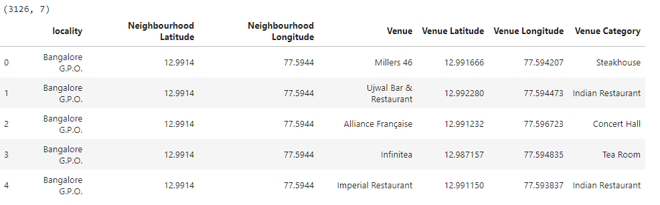
Data of Neighborhoods

Slide 5
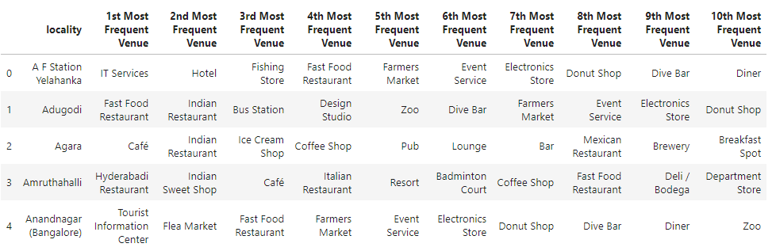
Clustering

Slide 6
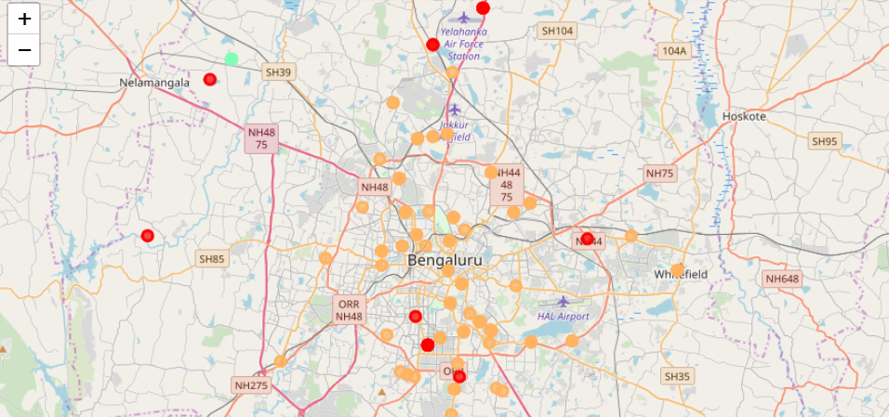
Clustering ( Visualization)

Slide 7
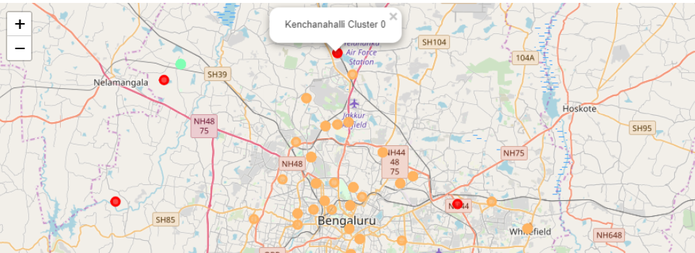
Results

Slide 8
Conclusion
Considering the above clustered data, we can conclude that it will be better to start a new “coffee shop” at cluster 0 location than opening a new “restaurant”.
The most suitable location would be between localities “Kenchanahali” and “A F Station Yelahanka” in cluster 0.

